Slide 1

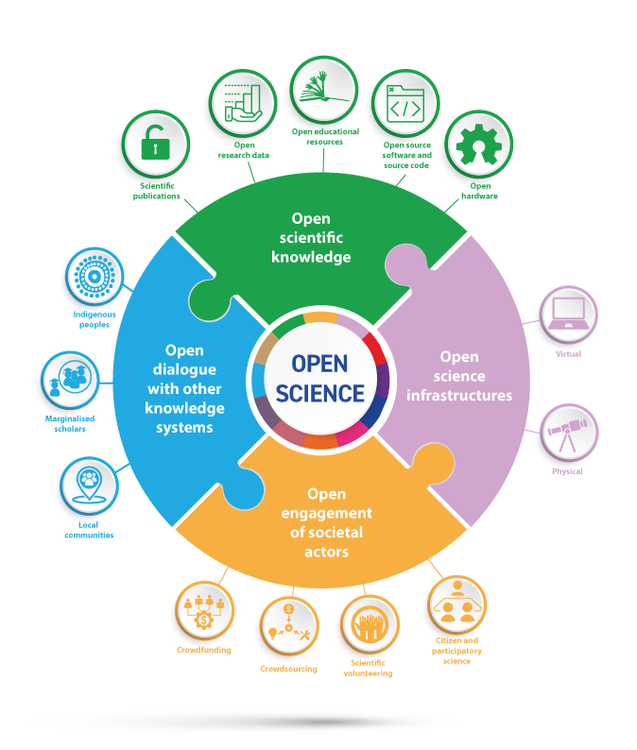

Adrien Fillon
09/10/2025
Should we be wary of open science?
TWIN4MERIT,
University of Cyprus
University of Cyprus

Slide 2
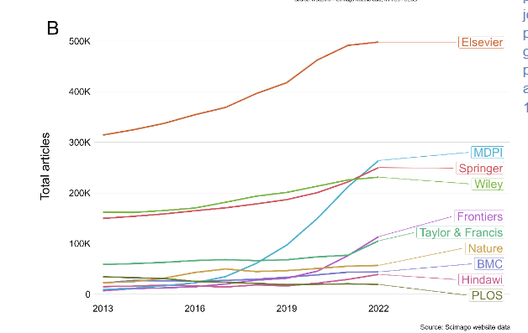
+1080%
+675%
In 3 Years
Hanson, M. A., Barreiro, P. G., Crosetto, P., & Brockington, D. (2023). The strain on scientific publishing (arXiv:2309.15884). arXiv. https://doi.org/10.48550/arXiv.2309.15884

Slide 3
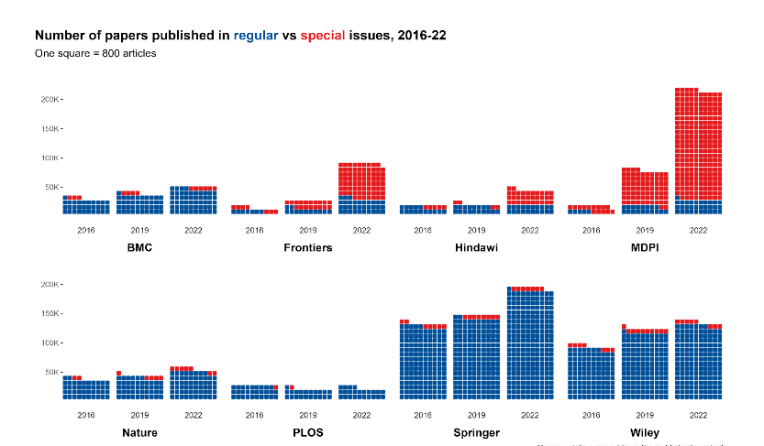
Hanson, M. A., Barreiro, P. G., Crosetto, P., & Brockington, D. (2023). The strain on scientific publishing (arXiv:2309.15884). arXiv. https://doi.org/10.48550/arXiv.2309.15884

Slide 4
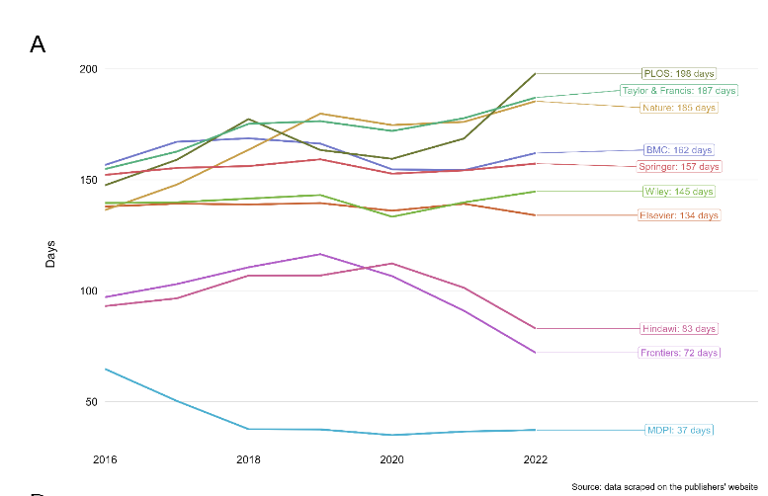
Hanson, M. A., Barreiro, P. G., Crosetto, P., & Brockington, D. (2023). The strain on scientific publishing (arXiv:2309.15884). arXiv. https://doi.org/10.48550/arXiv.2309.15884

Slide 5
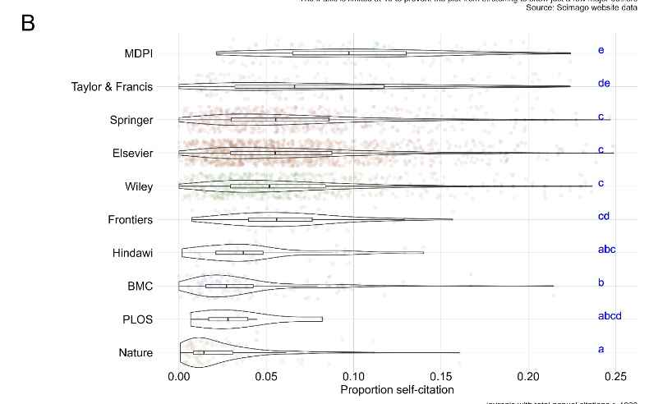
Hanson, M. A., Barreiro, P. G., Crosetto, P., & Brockington, D. (2023). The strain on scientific publishing (arXiv:2309.15884). arXiv. https://doi.org/10.48550/arXiv.2309.15884

Slide 6
Springer
Taylor and Françis
731 Million € first semester 2025
+7%
+25% from open access publications
HALF-YEAR FINANCIAL REPORT , Springer Nature, 2025
+11,9% – mostly from open access publications
Informa PLC 2025 Half Year Results

Slide 7
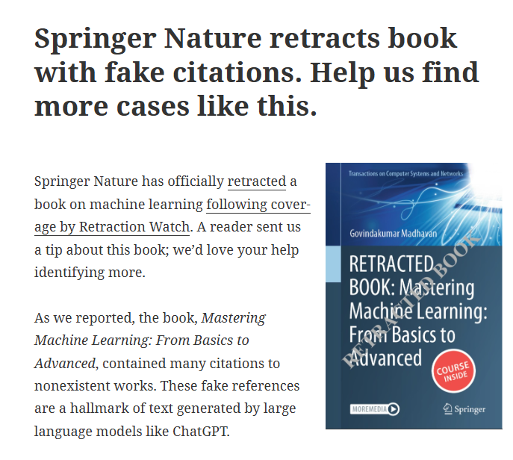
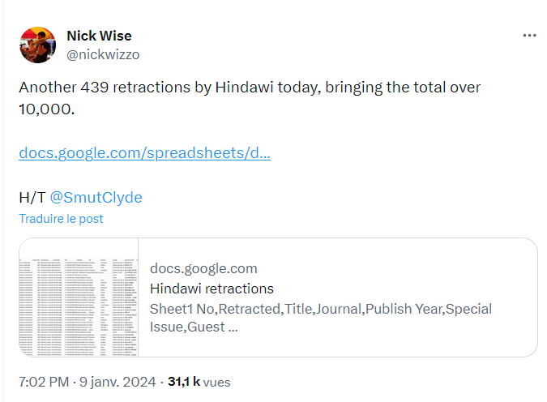
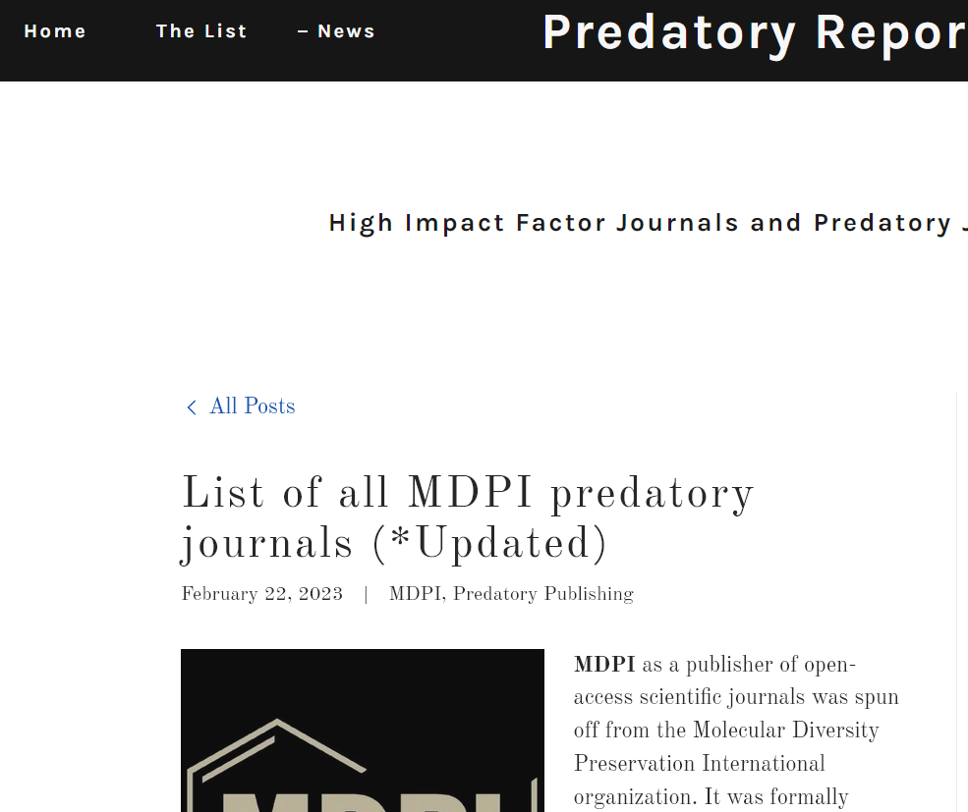
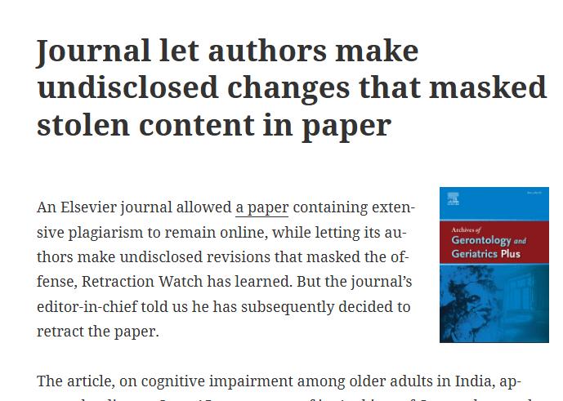
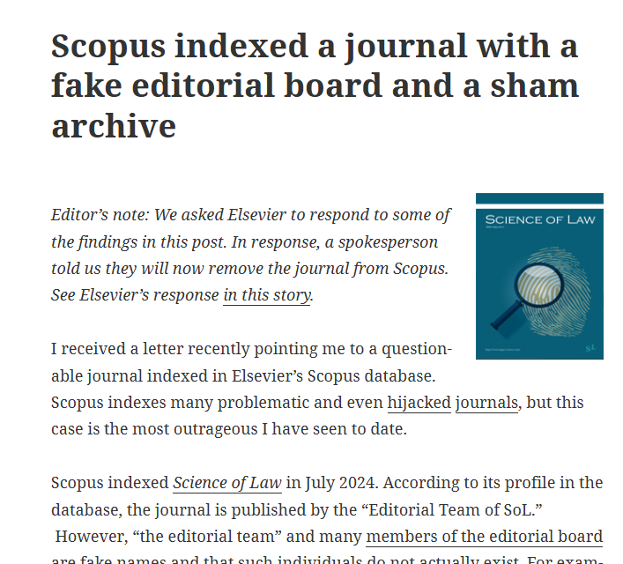
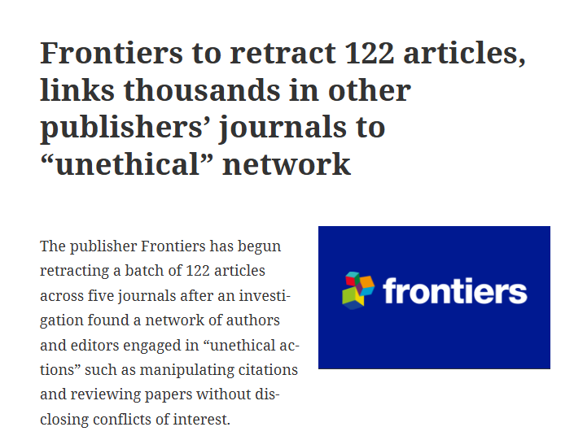
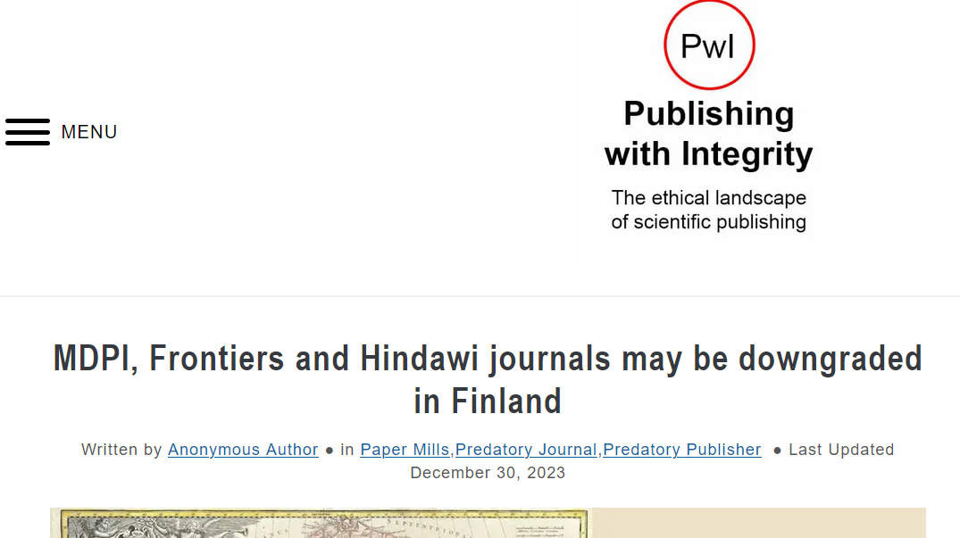
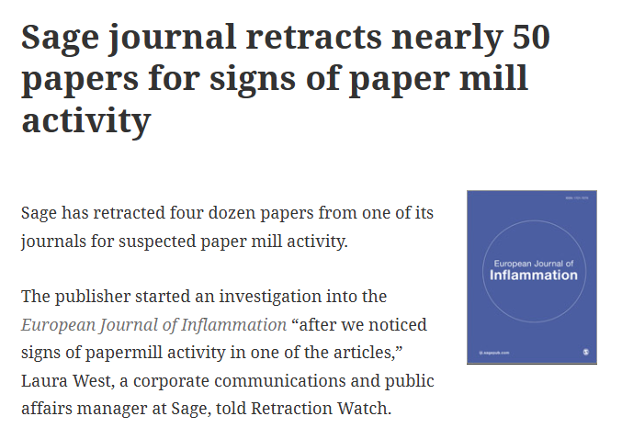
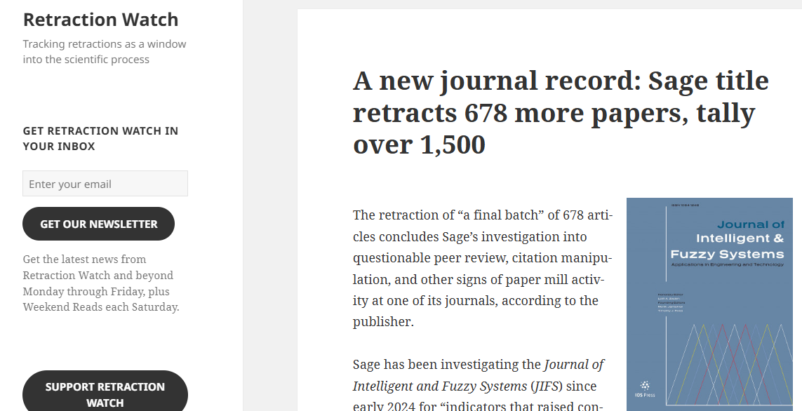

Slide 8
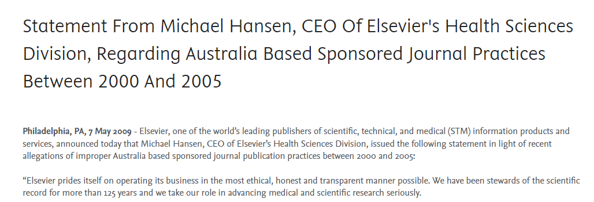
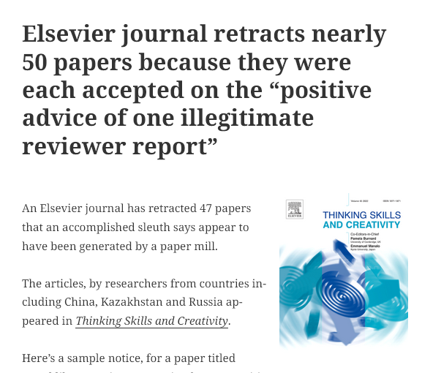

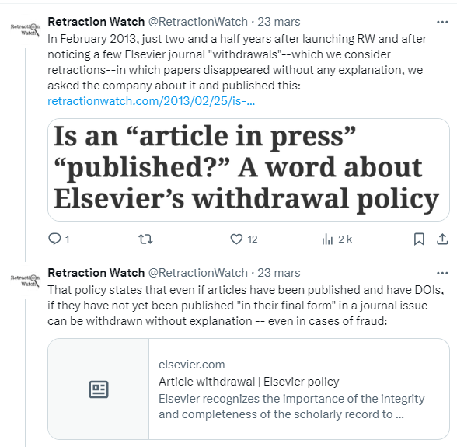
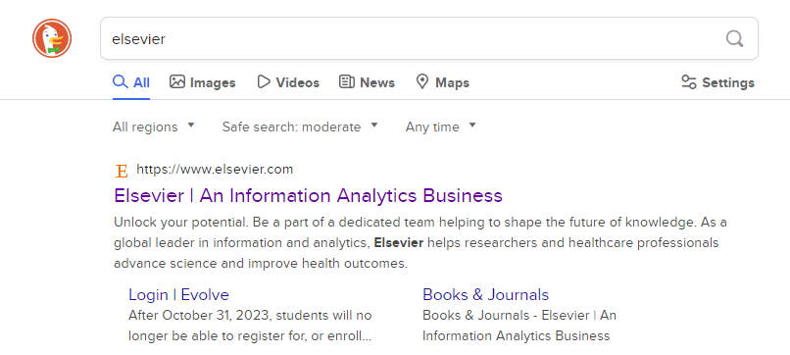
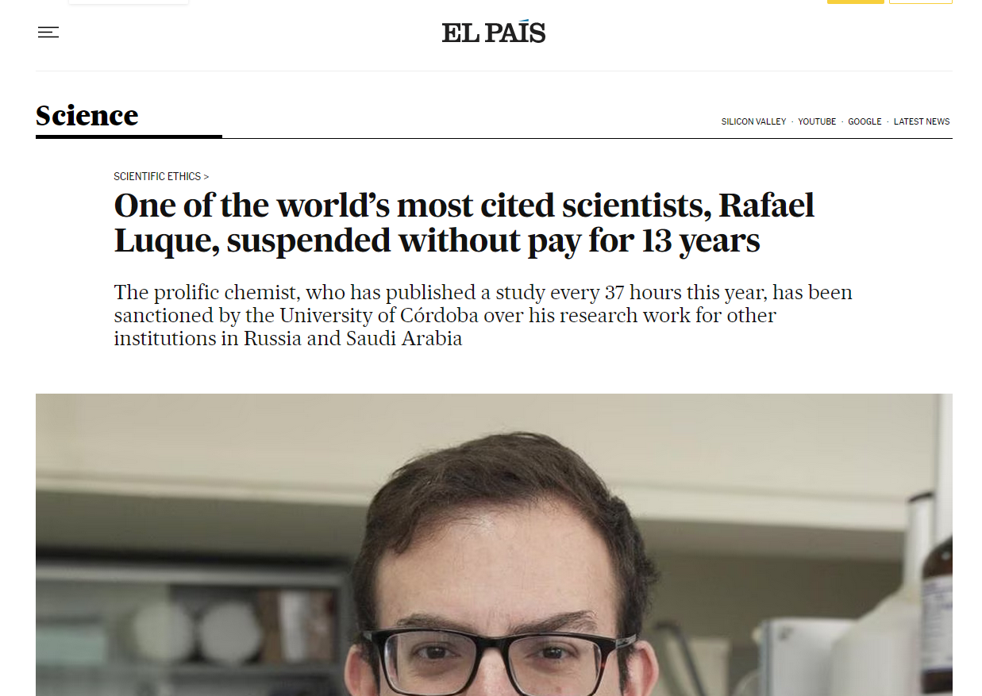
Sponsored articles
Paper Mill
Incredible publication rate
Notes:
Et je vais vous prouver que Elsevier n’est définitivement pas un éditeur scientifique.

Slide 9
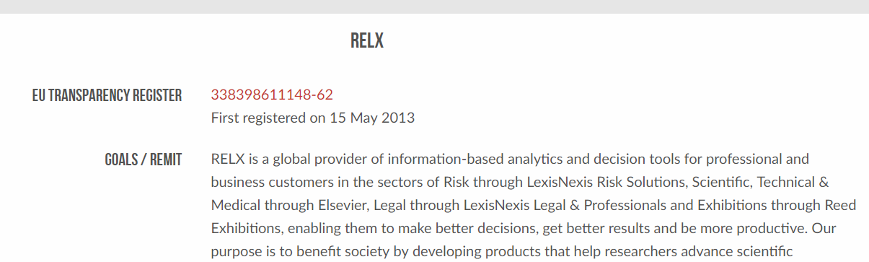
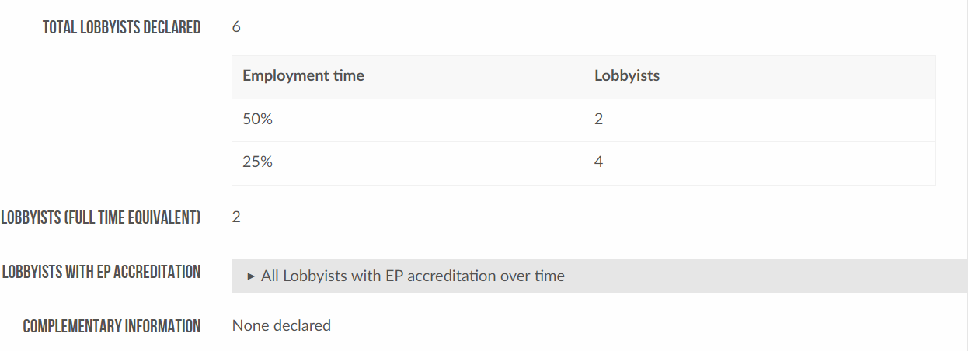
LobbyFacts.eu. (2023). RELX. Consulted October 12, 2023, at https://www.lobbyfacts.eu/datacard/relx?rid=338398611148-62

Slide 10
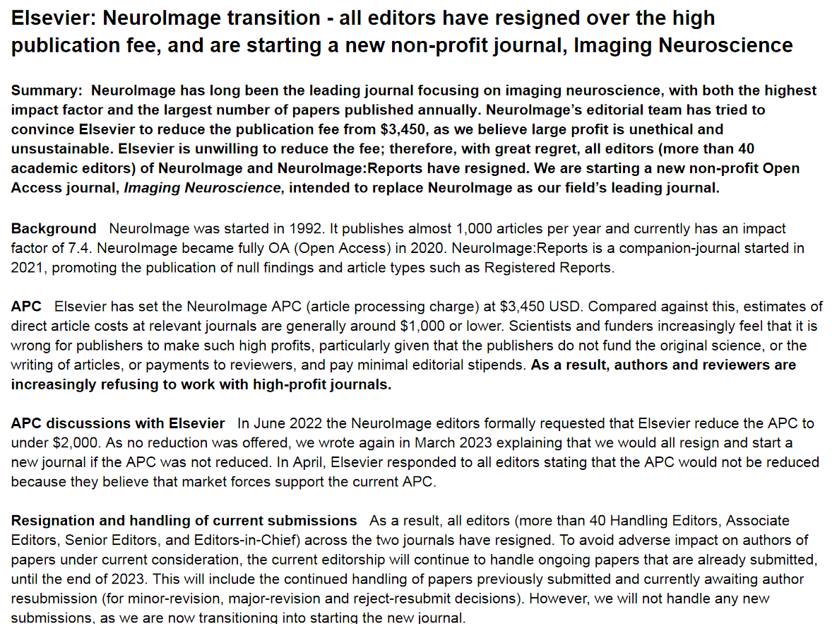

Slide 11
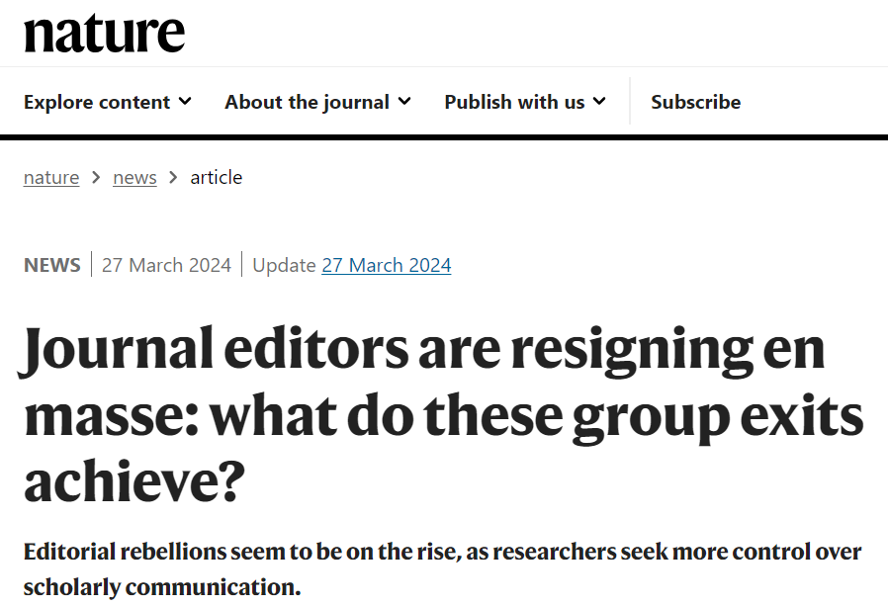
Resignation
NeuroImage – March 2023
“It wasn’t that we were opposed to the principle of open access,” she says. Instead, the editors were deeply opposed to the article-processing-charge model, in which authors are charged fees to publish their papers open access. The team decided to resign only after a year of discussions with the publisher about alternative models failed to produce a compromise”
Critical Public Health – July 2023
BMC Pregnancy and Childbirth – February 2024
BMC Women’s Health – February 2024
Syntax – March 2024

Slide 12
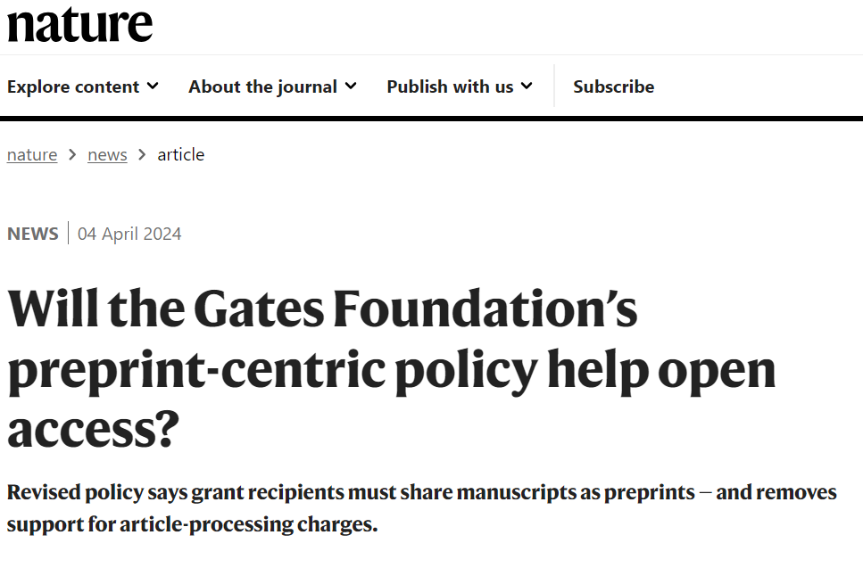
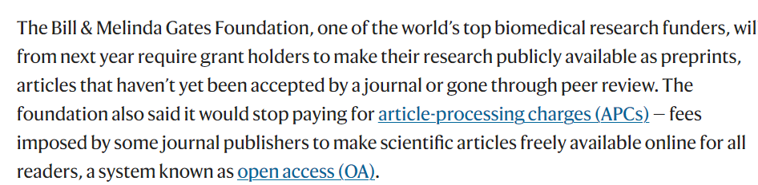

Slide 13
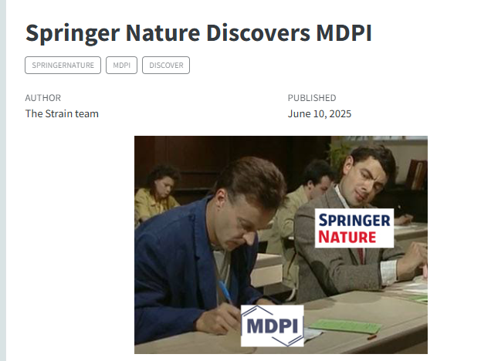
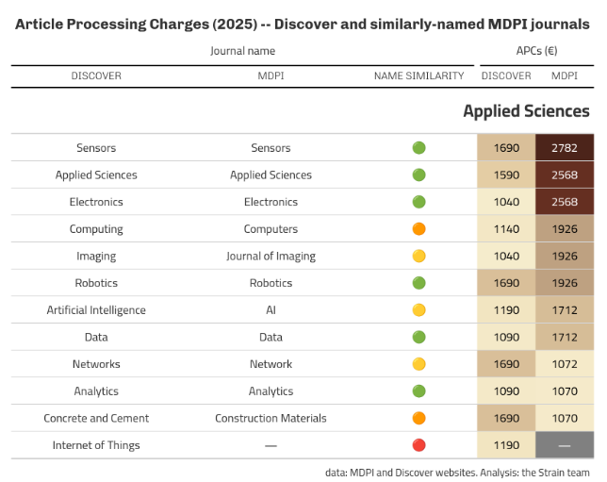

Slide 14
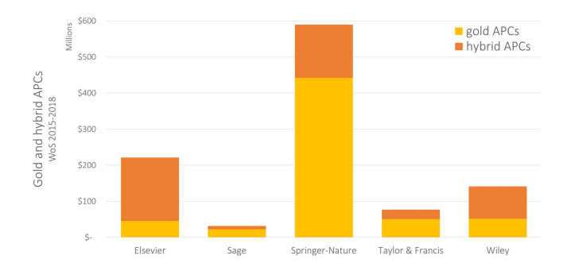
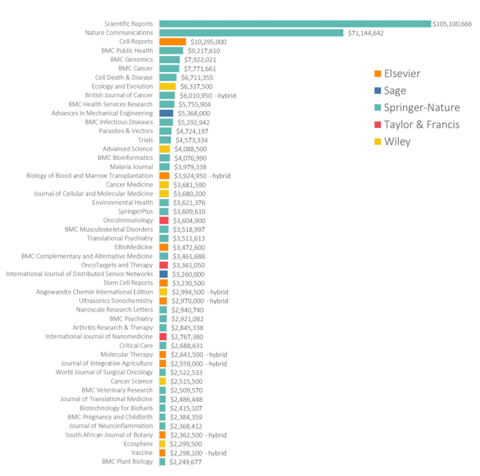

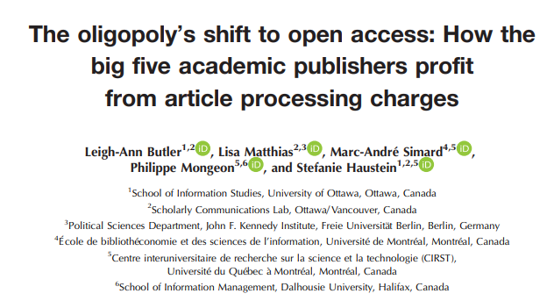

Slide 15
PART 1 CONCLUSION
All publishers are predatory, their own way
It’s terribly hard to correct science, because of publishers' unwillingness to protect publication process from bad papers and withdraw papers promptly.
The publishing market is broken, as there is an oligopoly by 5 publishers, far too big to fail
Publishers gets a lot of money from APCs (more than 1,06 billion before the 2019 exponential), and don’t care about the editing process leading to en-masse resignations
Publishers love Open Science, but mostly because they benefits from APCs and data selling (directly or indirectly)

Slide 16
What can we do about it?

Slide 17
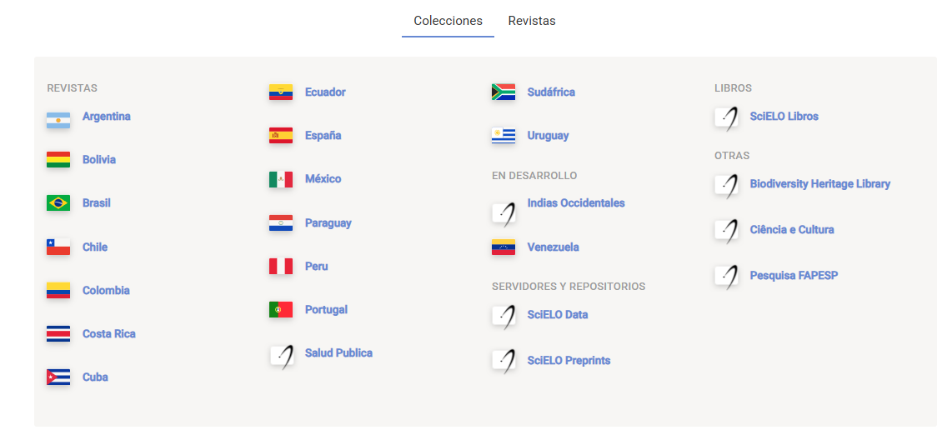
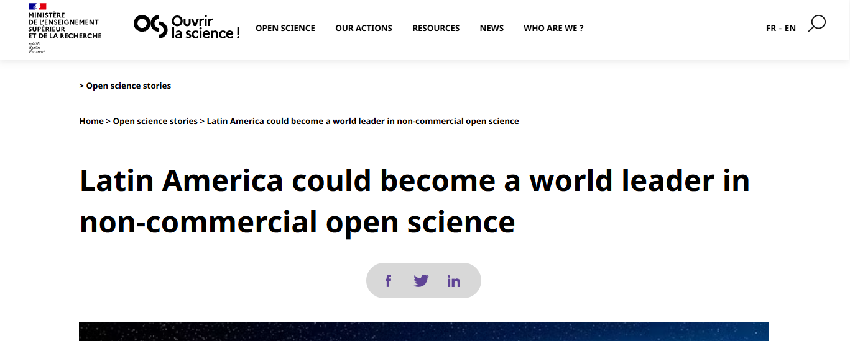
Example of South America
Current Research Information Systems (CRIS)
Latindex (Spanish and protuguese langages)
SciELO
Redalyc
BrCris (Brazil)
PerúCRIS
Europe : Institutional level (university)
South America : National level (with collaboration across countries within the region)
Most of the journals do not have impact factor
Out of 1619 journals from SciELO – 1048 are not even listed in DOAJ
Bosman, J., Frantsvåg, J. E., Kramer, B., Langlais, P.-C., & Proudman, V. (2021). OA Diamond Journals Study. Part 1: Findings. Zenodo. https://doi.org/10.5281/ZENODO.4558704
Notes:
(CRIS) emerged in Europe in the 1990s, expanding primarily at the institutional level, within universities. The European Organization for International Research Information (EuroCRIS) was founded in 2002,

Slide 18

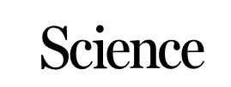
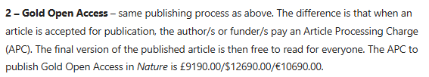
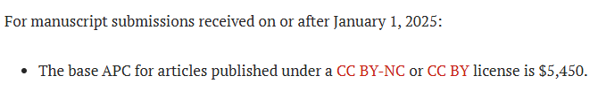
Historical alternative
Springer nature
American Association for the Advancement of Science
Revenue, 2022
$2,1 billion
Revenue, 2022 $119,582

Slide 19
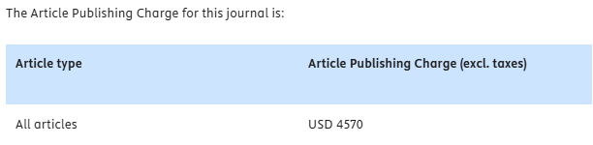
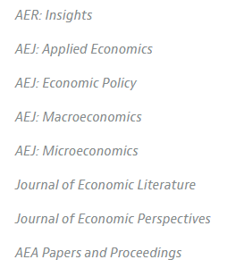
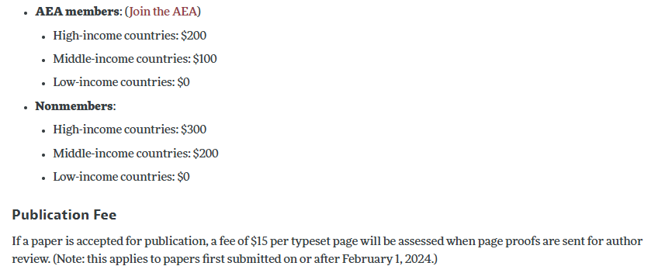
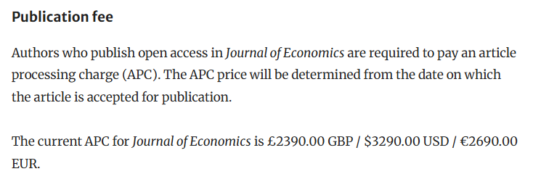
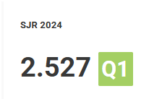

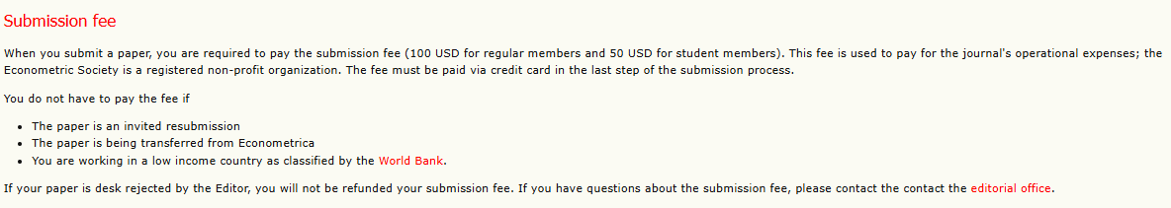
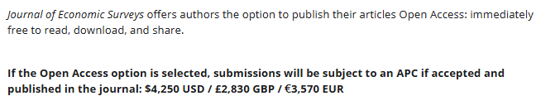
Economics
Researchers association
For profit journals
American Economic Association
Journal of econometrics (Elsevier)
Journal of economics (Springer)
The Econometric Society
Journal of Economic Surveys (Wiley)

Slide 20
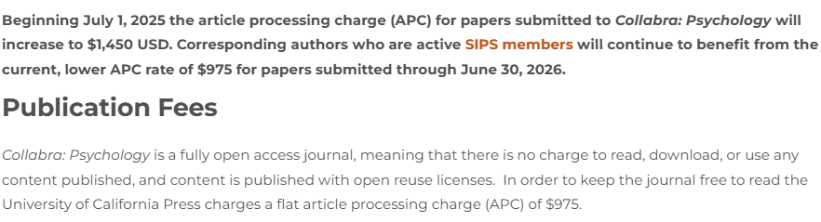
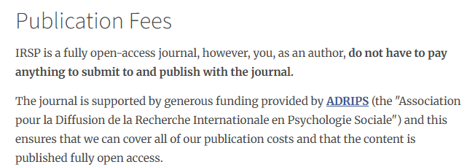


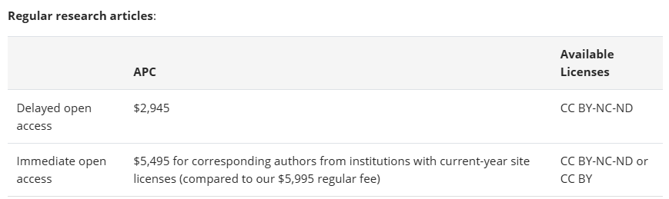
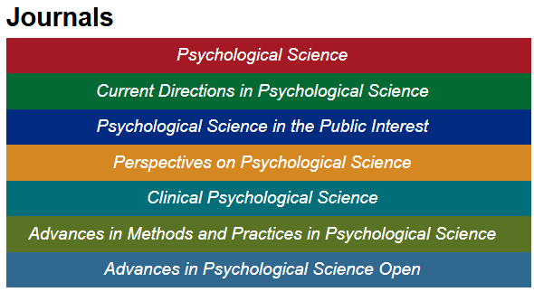
Psychology
Collabra: Psychology
Researchers association
French association in social psychology
American Psychological Association
Meta-psychology
Proceeding of the National Academy of Sciences
Association for Psychological science

Slide 21
Add complexity
A conclusion from the review of the economics journal could have been: create more researcher’s associations that run their own journals for less money
However, the review from psychology indicates that the problem can remain
But also that APCs can completly disappear if compensated by external funding
(so is the South American Example)
No time to read the published literature
No time to review the articles
AI is destroying the peer-review process (in writing articles and in writing review)
Structural costs – submission systems - are increasing without added value
Editors and reviewers are still not paid to do their job
All of it is said without discussing other aspects of open science: access (and review) of data, script, methods, computational reproducibility, which would also cost more to take care of
We don’t have evidence that the peer-review system works as intended
We have indications it does not (file drawer problem - p-hacking – paper mills – data and image manipulation – fake journals – « special » issues – faked editorial boards – unethical network of peer reviewers ...)
But (as far as I know) we don’t have better systems

Slide 22
What are Article Processing Charges ?
We don’t know
Even Journals don’t know.
Submission systems
Proofreaders
Secured servers (and sometimes printing)
Inflation (but it increases at a higher rate than inflation)
The « loss of money » made by making libraries pay the access
IRSP -> 500e per article
AEA -> around 900e per article
Collabra -> 1500e per article
More than 1500e per article?
Are there ways to lower the cost ?

Slide 23
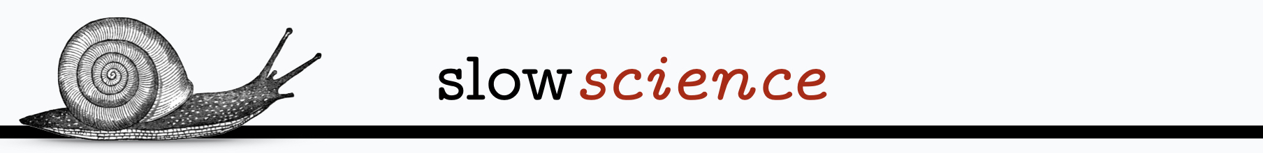
Individual versus system
Give priority to journals that charge reasonably while having good impact factor
Reward alternatives to « articles »
Octopus system
Making the best out of metadata for machine-readable scientific output
Do better at creating a fair research system by and for researchers.
And if possible, in non-for-profit journals
Get the help of governments to fight publishing predation
Governments are more willing to pay for APCs than not making the final output open (even with open preprints)!
Do not publish openly but give access to a preprint if APCs are too high
Pay for membership in a researcher’s association if the money goes to charges covering
Slow science : reward better science than more science
(good luck finding metrics)
Notes:
Most take-away messages are « publish less – publish better » but man I am a postdoc, i need to follow indicators just to survive and hope to secure a position.

Slide 24
APCs was a (recent) decision from for-profit publishers to make the authors pay to publish the work they wrote in journals they (still) pay to read
In an ecosystem where everything is basically a pdf
Individual and systemic solutions exist and are already used
We at least need to understand what are APCs and for what exactly we are paying.
Transparency
Trust in the editorial process
Rationalisation and effectiveness of science production

